Slide 1
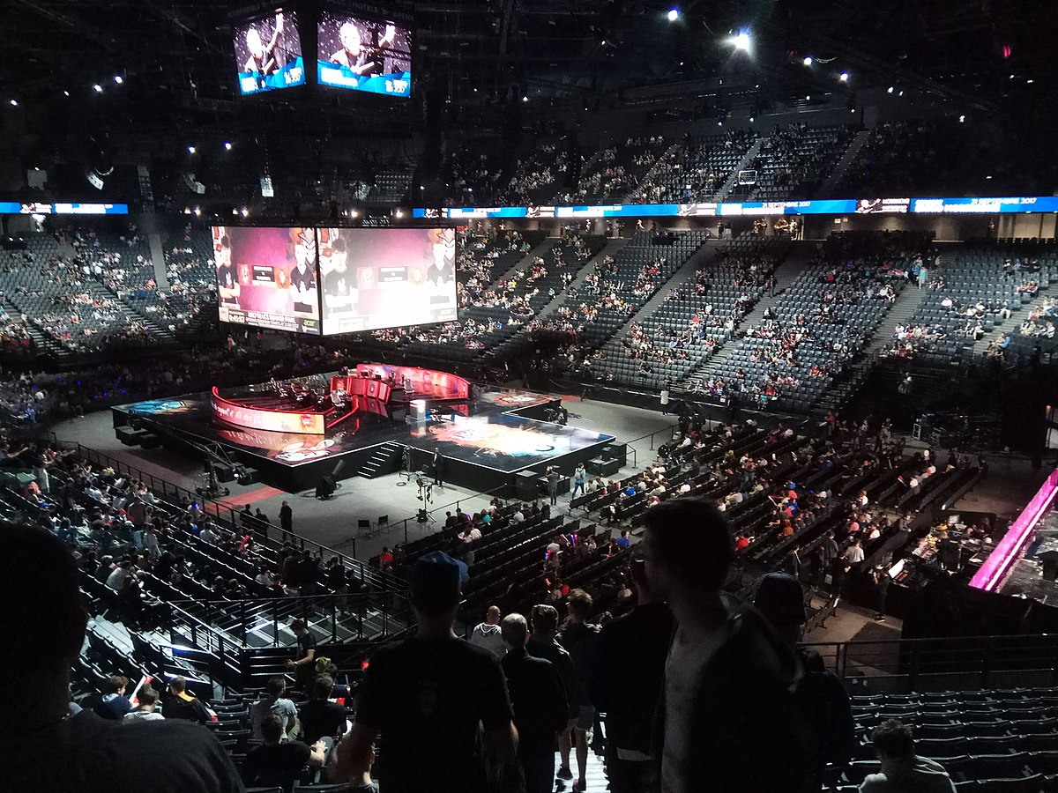
The impact on economy and tourism for first host city of the League of Legends European Championship finals

Slide 2
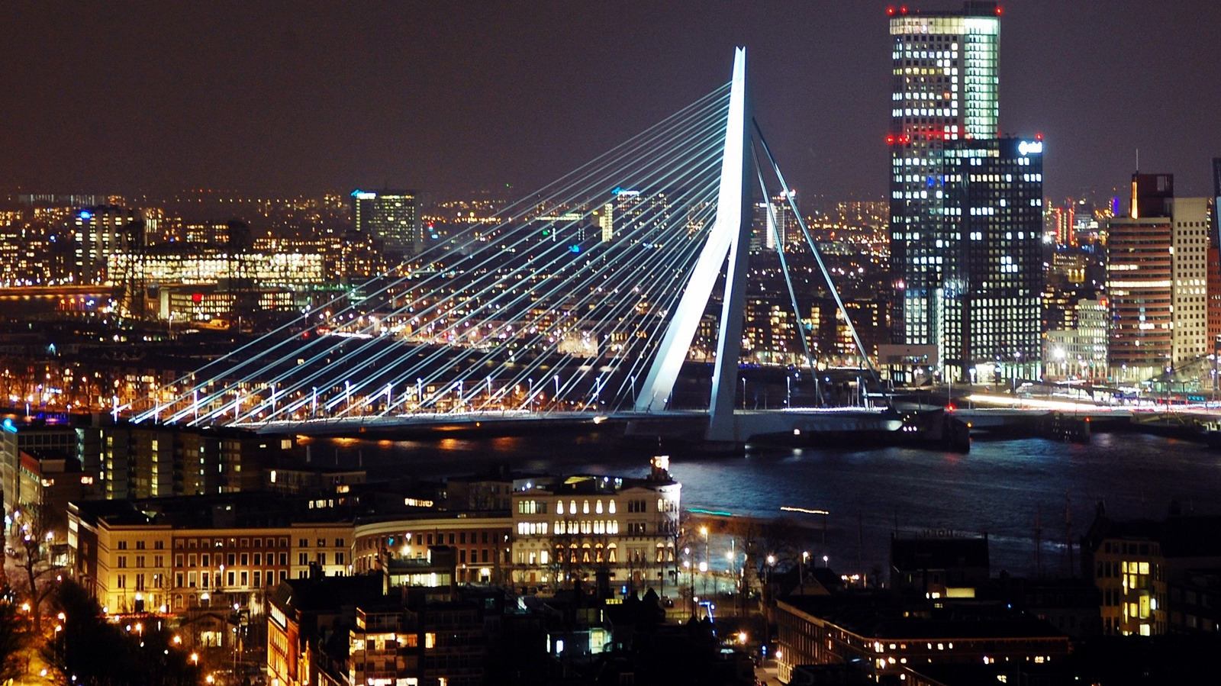
The League of Legends European Championship Spring Split Finals contributed over €2m to Rotterdam's local economy in just two days with over 87% of attendees coming from outside of the city

Slide 3
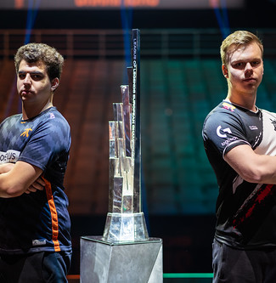
Riot Games today reveals the economic impact the first League of Legends European Championship (LEC) Finals had on the host city of Rotterdam. In association with Burson Cohn & Wolfe Sports, the leading firm within host city partnerships, Riot Games developed a programme inspired by traditional sports structures that saw over 40 cities bid to host the first LEC Finals. Analysis of the LEC Spring Finals held at the Ahoy Arena in Rotterdam on April 13th and 14th shows impressive economic impact that outperforms other sports events of similar size and length, in hockey, soccer and basketball.

Slide 4

This economic impact analysis concludes that the LEC Spring Finals contributed €2,358,417 to the local economy of Rotterdam. The study combines personal on-site surveys with Riot Games' verified accounts and ticket-sale data from the event and found the average guest spent €52.6 per day and 87.13% of the event's guests were non-local visitors. Alongside the measurable impact, the study also found additional impacts such as the future potential of tourism with visitors stating they would be willing to travel long distances to visit the LEC. The Spring Finals hosted visitors from China, South Korea, Peru and 37.83% of international visitors stated they would consider moving to Rotterdam if the right job opportunity became available.

Slide 5
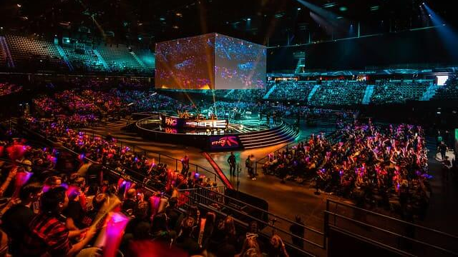
We were thrilled to host Riot Games in our venue (2016 for the EU LCS and 2019 for the LEC Spring Finals). Our indoor arena is made for big and exciting sporting events and is the perfect location in Rotterdam, and even in the Netherlands, for esports tournaments. Amazing atmosphere, great audience and we would love to host more esports events in the future!", according to CEO of Rotterdam Ahoy, Jolanda Jansen.

